Slide 1
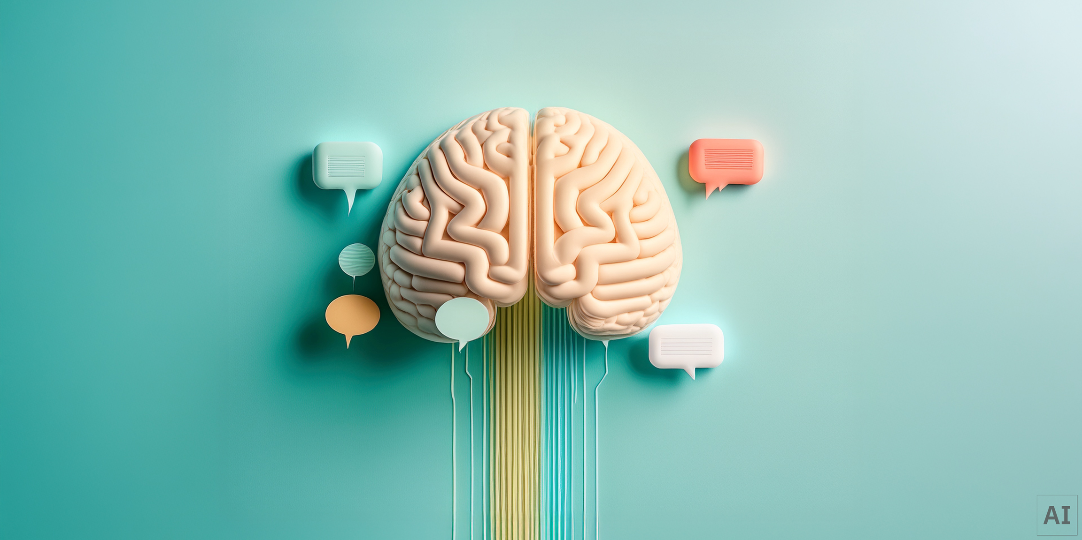
Fernando Reyes: Emerging AI Enthusiast
Hello! I'm Fernando Reyes, a passionate first-semester college student deeply immersed in the world of Artificial Intelligence. My journey began in high school, and I'm excited to continue exploring this dynamic field.
Discover my AI projects and assignments on my GitHub Portfolio.
https://github.com/frhubgit/Fernando-Reyes-AI-Portfolio
Notes:
1

Slide 2
My Foundational Learning Journey in AI
High School Spark
My fascination with AI ignited during my high school years, driving me to pursue further education in this field.
Intro to Machine Learning
Gained foundational knowledge in ML concepts, algorithms, and applications.
Python Coding (Basics)
Developed essential programming skills in Python, the cornerstone for AI development.
Database Theory & Design
Understood data structures and management, crucial for robust AI systems.
History of AI
Explored the evolution of AI, its milestones, and ethical considerations.
Notes:
2

Slide 3
Lab Assignments & Coursework
During my first semester, I've completed several lab assignments that have helped me apply classroom concepts in practical ways. These assignments represent my early learning in AI and programming.
Preparing Data
Database Project
AI Roleplay Scenario
An iypnb based on preparing data for machine learning, teaches ne how to clean, transform, and engineer features to create high-quality datasets that lead to better model performance.
A coursework assignment where I designed a database for a fictional application. This helped me understand database normalization, relationships, and practical schema design.
A group-based project assignment where we were tasked to go through the process of designing and implementing an A.I. with fictional roles and what roles are purpose served towards the goal.
Notes:
3

Slide 4



Building a Foundation in AI & Tech
My early coursework has equipped me with essential technical and conceptual skills vital for a career in AI.
Technical Proficiencies
Core AI Competencies
Python Programming (fundamentals)
Algorithmic Thinking
SQL & Database Management
Data Interpretation
Machine Learning Basics
Problem Solving
Data Preprocessing
Understanding AI Ethics
Notes:
4

Slide 5
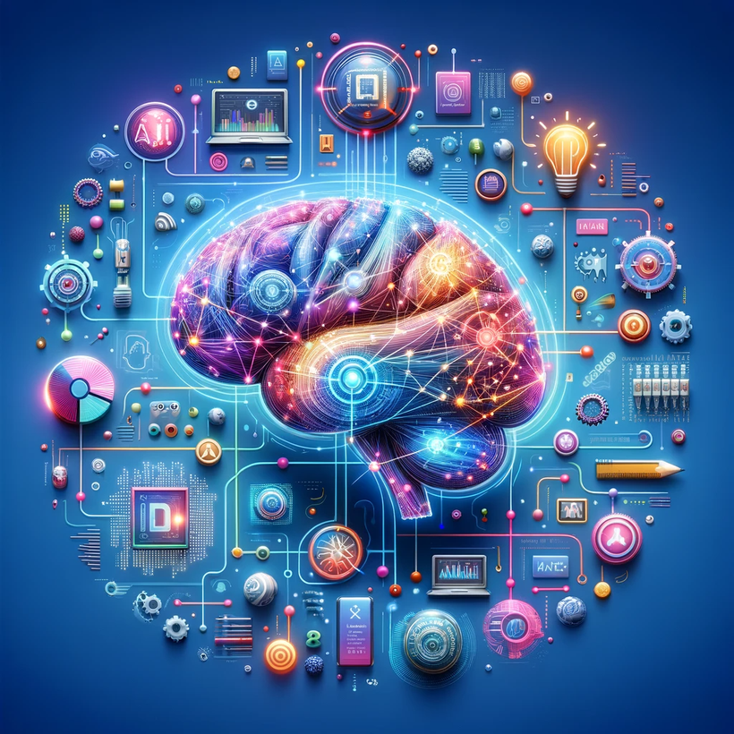
Future Aspirations & Connection
My initial college experience has solidified my passion for AI, and I am eager to continue my growth and contribute to innovative projects.
1
2
Deepen ML Knowledge
Contribute to Open Source
Explore advanced machine learning algorithms and neural networks.
Actively participate in open-source AI projects to gain practical experience.
3
Specialized AI Domains
Investigate areas like natural language processing (NLP) or computer vision.
Let's Connect!
Email: fernandoreyes.hcc@gmail.com
LinkedIn: Fernando Reyes
Notes:
5

